Slide 1

Twitter Sentiment Analysis Using Logistic Regression and Naïve Bayes with Enhanced Text Classification

Slide 2



Introduction
Twitter sentiment analysis is the process of determining the emotional tone behind a series of tweets, categorizing them as positive, negative, or neutral. This technique is widely used by businesses, researchers, and marketers to gauge public opinion on various topics, brands, or events. Importance of Twitter Sentiment Analysis
Brand Monitoring: Companies can track how their brand is perceived in real-time by analyzing user sentiments expressed in tweets.
Crisis Management: Early detection of negative sentiments can help organizations address potential PR crises before they escalate.
Customer Insights: Understanding customer feedback provides insights into product satisfaction and areas needing improvement.
Competitive Analysis: Businesses can monitor competitors' mentions to understand their market position and customer perceptions.
Trend Prediction: Sentiment analysis can reveal emerging trends based on public sentiment towards specific topics or products.

Slide 3


Technology Used
NumPy: NumPy is a Python library used for working with arrays. It also has functions for working in domain of linear algebra, fourier transform, and matrices
Pandas: Pandas is a Python library used for working with data sets. It has functions for analyzing, cleaning, exploring, and manipulating data.
Scikit-learn: Scikit-Learn, also known as sklearn is a python library to implement machine learning models and statistical modelling. Through scikit-learn, we can implement various machine learning models for regression, classification, clustering, and statistical tools for analyzing these models.

Slide 4

Logistic regression: it is a statistical method used for binary classification tasks, where the goal is to predict the probability of a binary outcome based on one or more predictor variables. It is widely employed in various fields for tasks such as disease diagnosis, loan default prediction, customer churn analysis, and sentiment analysis in NLP
Natural language processing: it is the ability of a computer to understand human language . It is a component of artificial Intelligence that centre on instructing computers to efficiently examine massive volumes of natural language data.
Multinomial Naive Bayes: is a probabilistic classifier to calculate the probability distribution of text data, which makes it well-suited for data with features that represent discrete frequencies or counts of events in various natural language processing (NLP) tasks.

Slide 5
Model planning
Data Collection
Importing libraries
Data Preprocessing
Training and testing
Model training
Model Accuracy
Logistic Regression
Multinomial Naïve Bayes
Primary data
Secondary Data
Removing Stopwords
Stemming
Tokenization
vectorization

Slide 6

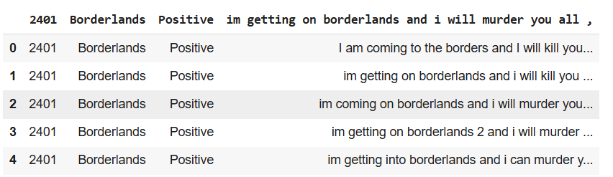
Modeling and analysing
After removing all the null values from the dataset, we begin our data preprocessing by checking the distribution of target column followed by removing stop words, stemming ,tokenizing the text data. Next, we convert the textual data to numerical data by using the word embedding technique of feature extraction or vectorization. Then we split our data into training and testing sets. Finally we apply our chosen algorithms to our model to determine the accuracy score or prediction value of our model

Slide 7

Enhanced Text Classification:
Enhanced text classification refers to advanced methodologies in the field of text categorization that improve the efficiency and accuracy of classifying text documents into predefined categories. This approach builds upon traditional text classification techniques by incorporating innovative strategies and technologies, particularly in handling unstructured data
Word Embeddings: Techniques like Word2Vec or GloVe transform words into vector representations, capturing semantic meanings and relationships between words, which can improve classification outcomes
Naïve Bayes: A probabilistic classifier that applies Bayes' theorem, assuming independence among features. It is effective for tasks like spam detection and sentiment analysis due to its simplicity and speed
Random Forest: An ensemble method that combines multiple decision trees to improve classification accuracy. It works well with large datasets and reduces the risk of over fitting
XGBoost: XGBoost, which stands for extreme Gradient Boosting, is an advanced machine learning library that implements a gradient boosting framework. It is widely recognized for its efficiency, flexibility, and performance in various predictive modeling tasks, including classification and regression.
Voting Classifier: The Voting Classifier is an ensemble learning method that aggregates the predictions of various base classifiers to produce a more accurate and robust final prediction. The Voting Classifier technique is used in machine learning to improve the performance of classification models by combining the predictions from multiple individual classifiers.

Slide 8
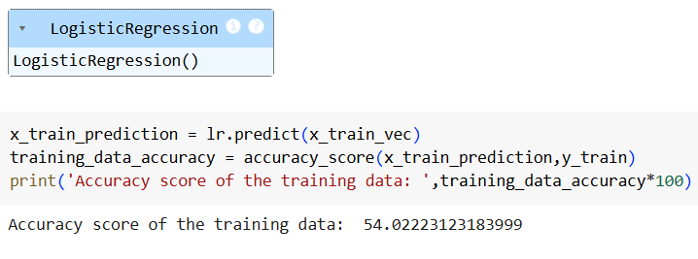
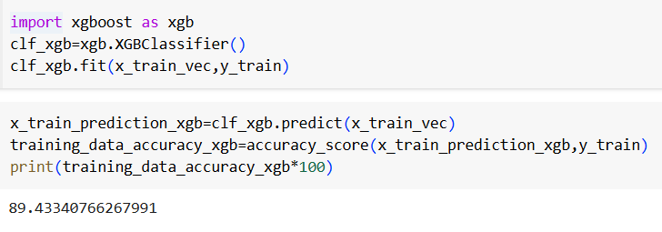
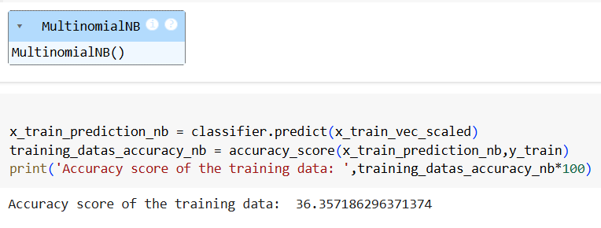
Result And Experimental Analysis
The accuracy score of training data of the Logistic Regression Model obtained as 54%
The accuracy score of training data of the XGBoost Model obtained as 89%
The accuracy score of training data of the Multinomial Naïve Bayes Model obtained as 36%

Slide 9
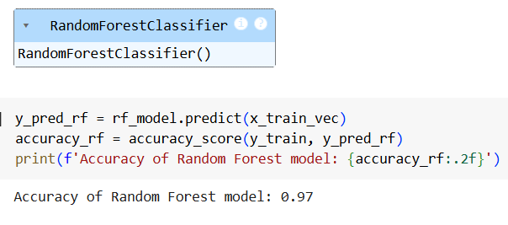
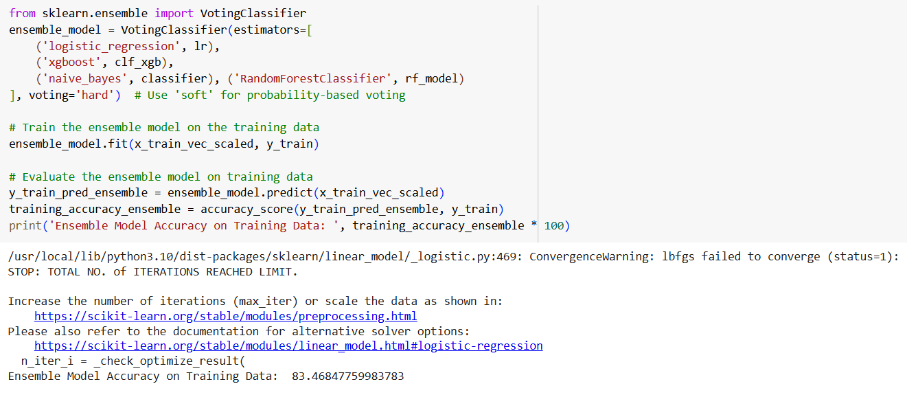
The accuracy score of training data of the Random Forest Classifier Model obtained as 97%
The accuracy score of training data of the Voting Classifer Model obtained as 83%

Slide 10
Conclusion
In this project, logistic regression model and multinomial naïve bayes model and some enhanced text classification techniques like random forest classifier, xgboost and voting classifier were successfully implemented employing various prominent algorithms from the python libraries and modules. After the collection of data was done, further processing of data was done. The null entries and missing datapoints were removed from the dataset and then finally we will get accuracy score of logistic regression model as 0.54, multinomial naïve bayes model as 0.36, xgboost model as 0.89, random forest classifier as 0.97, voting classifier model as 0.83.so,when we compare all the models random forest classifier model which is having a good prediction value than the remaining classification models is best for sentiment analysis where we have to predict wheather the given sentiment is positive , negative, neutral, unrelated to the dataset.

Slide 11

Thank YOU!

